Slide 1
April 2025, NSDI’25
Enabling Portable and High-Performance SmartNIC Programs with Alkali
Jiaxin Lin*¹, Zhiyuan Guo*², Mihir Shah¹, Tao Ji¹, Yiying Zhang², Daehyeok Kim¹ and Aditya Akella¹
*Equal Contribution
1
2

Slide 2
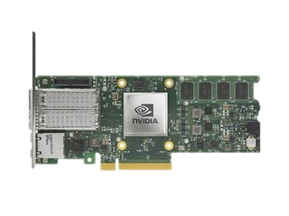
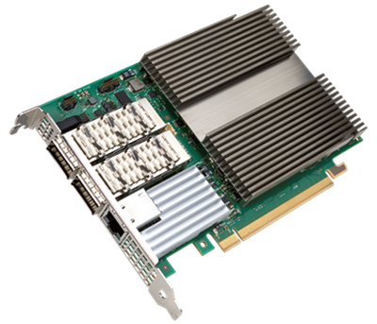
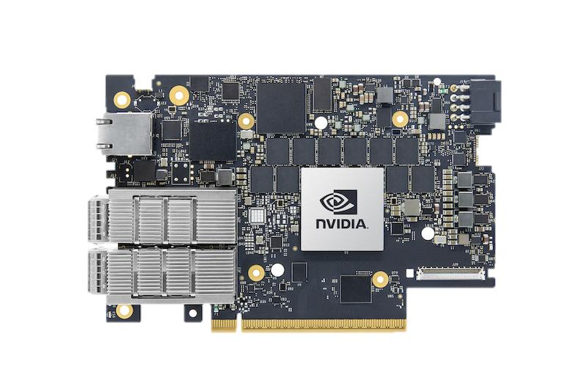
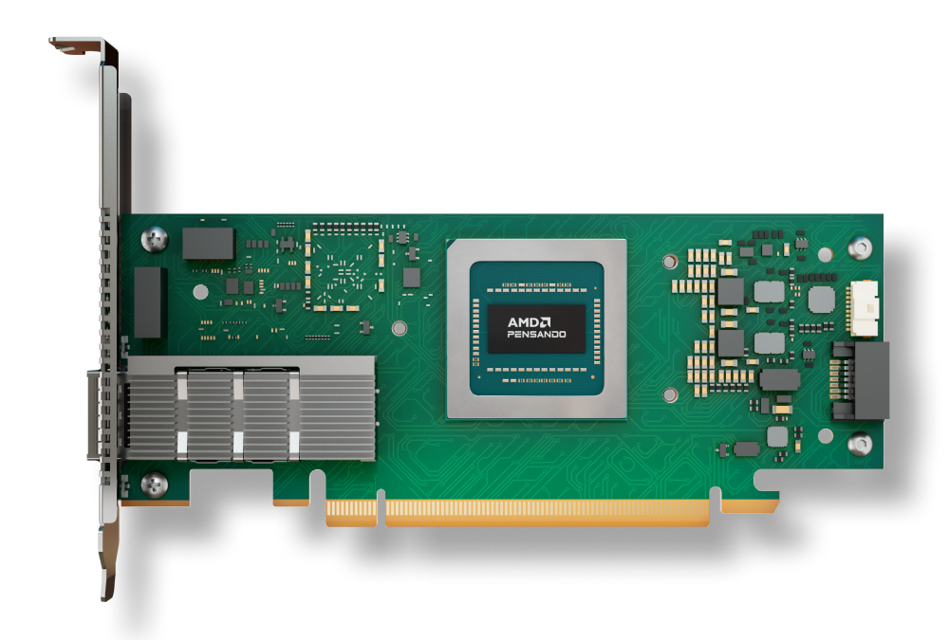
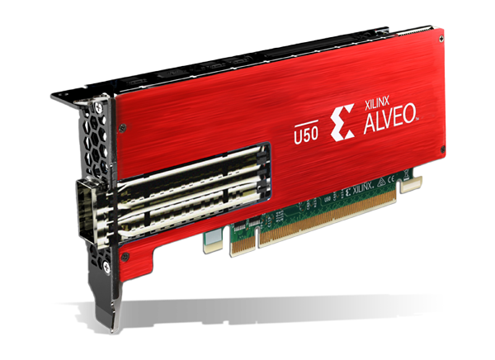
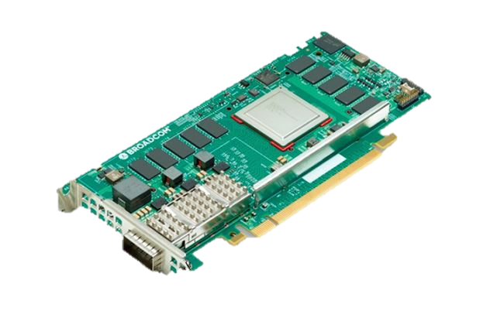
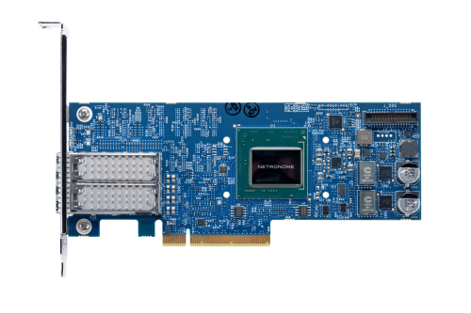
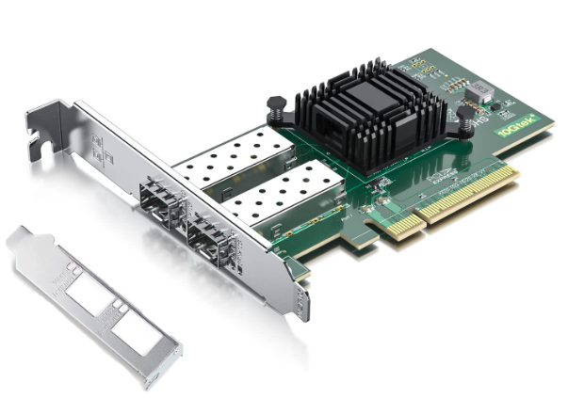
SmartNIC Trends
RSS
Middlebox
Transport
IPSec
LSO
Trend 1:Increasing number
of applications
Msg Process
Net Function
Intensifies programming barriers
Trend 2: Increasing number of hardware variants

Slide 3
Barriers of SmartNIC Programming #1 Low level parallel programming
MAC
void TCP_offload(pkt e){
hdr = parse(e);
win_update(hdr, win);
ack_gen(hdr);
dma_write(e);
}
64
Micro
Engines
4 Mem
Layers
DMA
Agilio NIC
SDK with 500+ MicroC lib functions

Slide 4
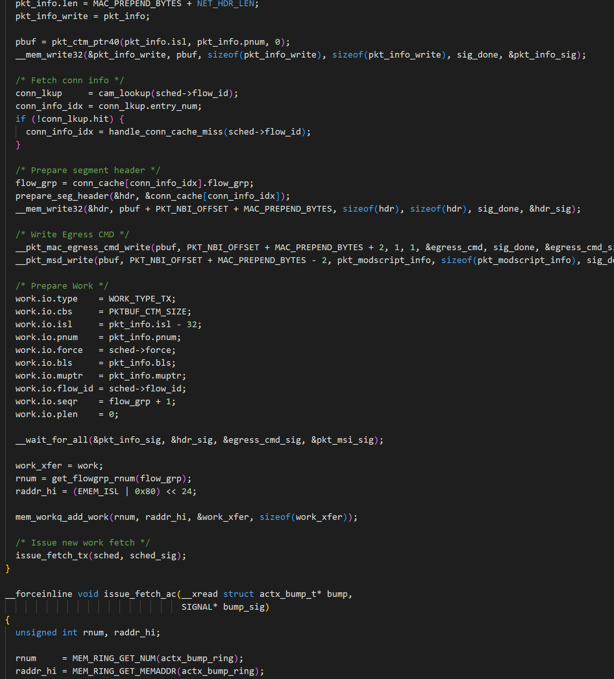
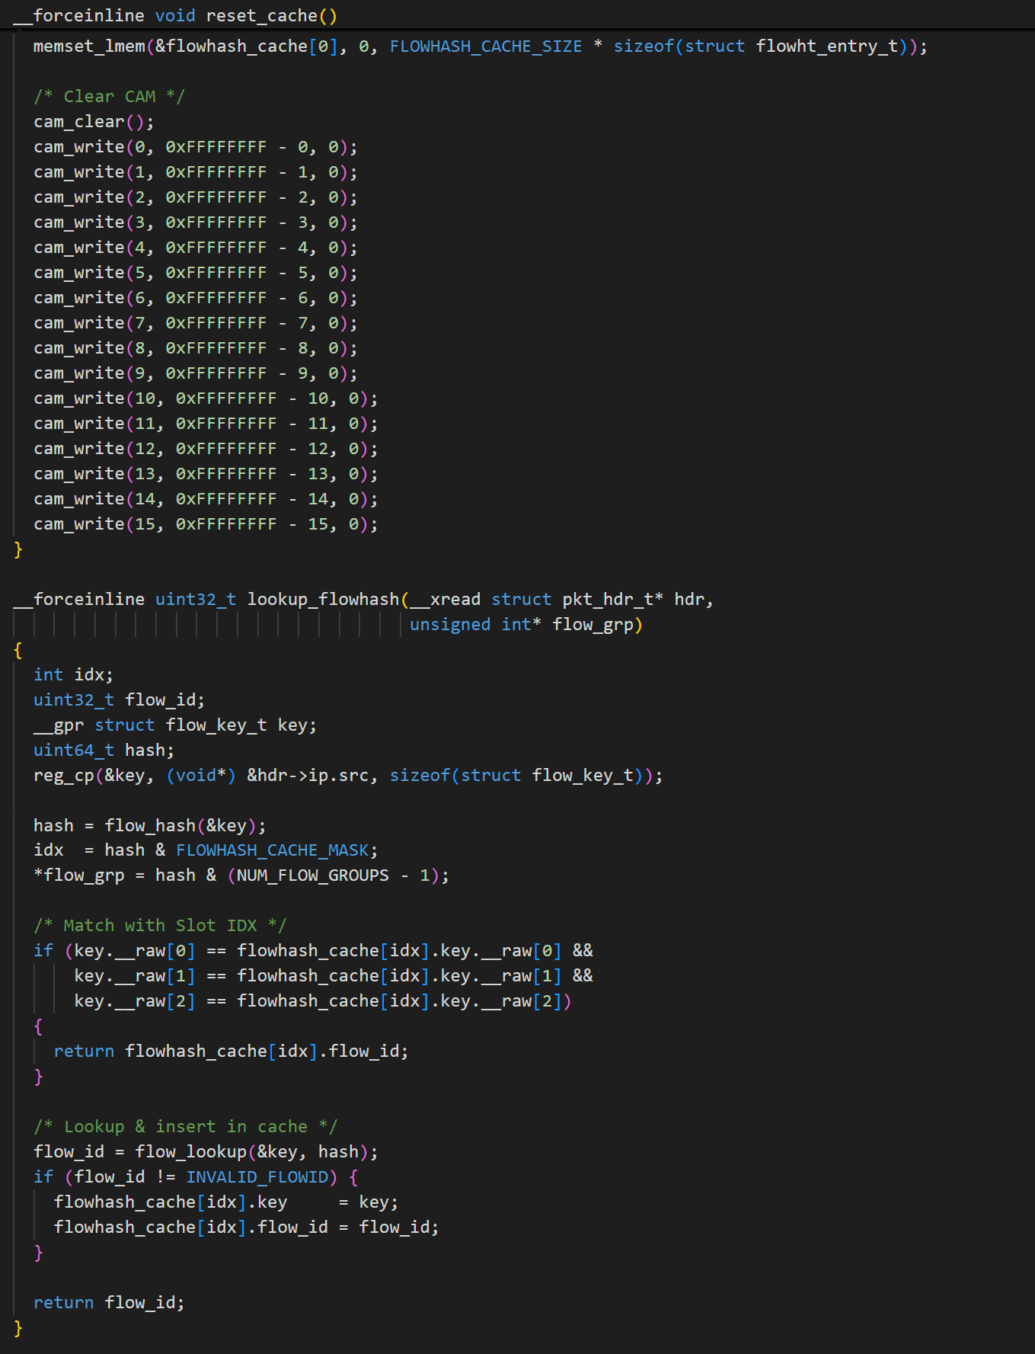
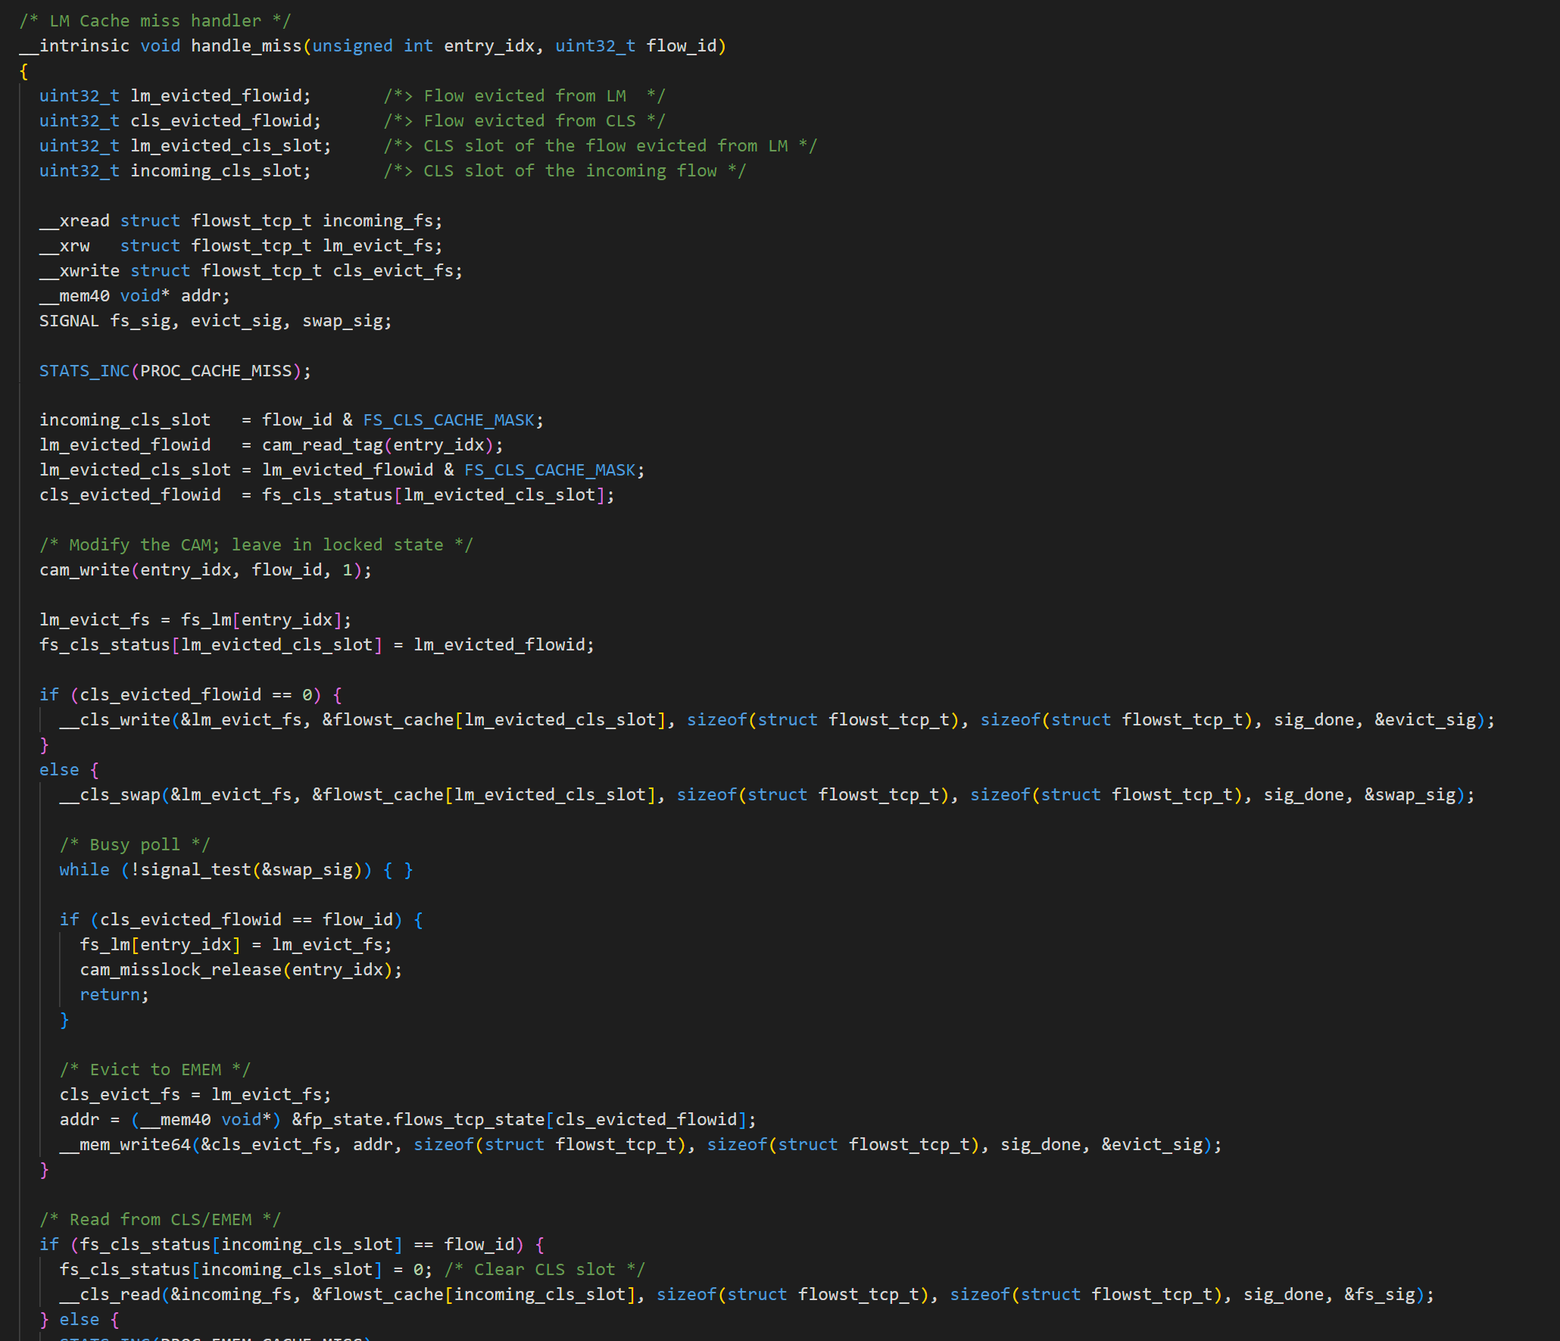
Barriers of SmartNIC Programming #1 Low level parallel programming
Packet Processing Logic
MAC
64
Micro
Engines
4 Mem
Layers
Low-Level Parallel Optimizations
DMA
Agilio NIC
Lines of Code Distribution
SDK with 500+ MicroC lib functions

Slide 5
Barriers of SmartNIC Programming #2 Non-portability
Agilio
FPGA
BlueField-2
Interfaces:
MicroC with Macros
Verilog (RTL)
DPDK + extern libc
Architectures:

Slide 6
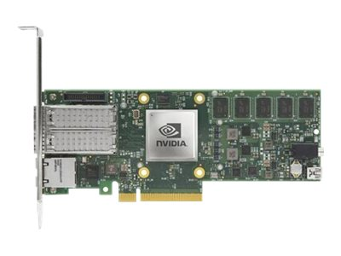
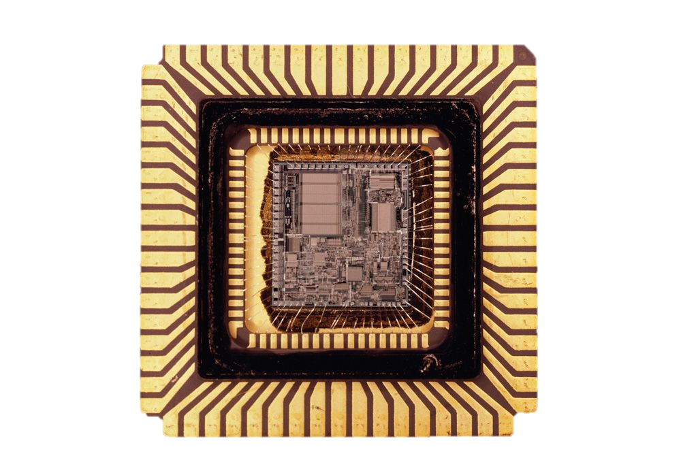
An Ideal Programming Framework
Target-agnostic Programming
Portability & Performance
Extensible
I don’t need to learn the microarchitecture.

Slide 7
Alkali: A Multi-Target Compilation Framework for NICs
Key insights:
An intermediate representation (IR) for NICs for building multi-target compiler infrastructure.
Automatic parallelization optimizations enable both portability and high performance.

Slide 8
Alkali Overview
Agnostic Programming
Portability & Performance
Extensible
A general IR captures all parallel execution semantics on NICs
Auto parallelization optimizations
Minimal Dev
Effort in Backend
Target-agnostic Programming
Portability & Performance
Extensible
Programming: Single threaded event processing
Alkali Compiler: Event handler graph αIR
NIC Backends: Simple code gen
OPT: Auto parallelization
FPGA
HDL
C/Python/P4
Agilio
MicroC
#include
BF2
ARM binaries
NIC Arch
Specs
PANIC
RISC-V binaries
NIC Perf
Specs
BF3
DOCA DPA
C code

Slide 9
Talk Outline
Target agonistic programming interfaces
Event handler graph-based αIR
Auto parallelization optimization
Evaluation

Slide 10
Target Agonistic Programming Interfaces
Run-to-completion, single threaded program.
Process and generate hardware events.
Import architecture specification, defines supported events.
Portable if: two NICs have the same arch spec.
agilio_spec.h
# include<agilio_spec.h>
void _net_recv(pkt e){
mac_hdr mac = buf_extract(e, 48);
tb_update(table1, mac, 1);
_dma_write(e, 0x8000);
}
void _net_recv(hdr_t hdr,buf_t data){}
void _dma_write(…){}
void _dma_read(…){}
void _mmio_doorbell(…){}

Slide 11
Talk Outline
Target agonistic programming interfaces
Event handler-graph-based αIR
Auto parallelization optimization
Evaluation

Slide 12
αIR Design
A common representation captures parallel execution patterns on NICs.
Type 1: Packet Parallelism
Type 2: Flow Parallelism
Type 3: Pipeline Parallelism
Flow1
MAC
DMA
MAC
DMA
MAC
DMA
Flow2
Pros: Maximizes parallelism.
Cons: Requires synchronization for state.
Pros: Supports global state.
Cons: Communication overhead.
Pros: No state synchronization.
Cons: Does not support global state

Slide 13
Express Three Parallelisms: Event Handler Graph
Event Handler:
Code block running in a compute unit.
Can be replicated.
H1
Events:
Triggers handler’s computation.
Express three parallelism and all possible combinations !
H2
H2
Event Controller:
Defines event steering and ordering rules among handler and its replicas.
H3
Persistent State:
State that persists across events, e.g., flow table, counters.

Slide 14
Talk Outline
Target agonistic programming interfaces
Event handler-graph-based αIR
Auto parallelization optimization
Evaluation

Slide 15
Auto Parallelization Optimization
Single Threaded Input
Best IR graph that runs fastest on the target NICs
Search all semantic equivalent IR graphs
Key questions:
How to navigate the complex search space.
How to improve the search efficiency.

Slide 16
Iterative Two-stage Algorithm to Guide the Search
handler_1(int a){
b = a+1;
c = a+1;
gen_event(c, b);}
handler_2(int c, b){
d = c+b;
dma_wr(d);}
handler (int a){
b = a+1;
c = a+1;
d = c+b;
dma_wr(d);
}
b = a +1
Pipeline Cutting Engines
c = a + 1
d=c+b
Algorithm: Graph Cut
dma_wr(d)
Mapping Engine

Slide 17
Iterative Two-stage Algorithm to Guide the Search
handler_1(int a){
b = a+1;
c = a+1;
gen_event(c, b);}
handler_2(int c, b){
d = c+b;
dma_wr(d);}
handler (int a){
b = a+1;
c = a+1;
d = c+b;
dma_wr(d);
}
b = a +1
Pipeline Cutting Engines
c = a + 1
d=c+b
Algorithm: Graph Cut
dma_wr(d)
Mapping Engine

Slide 18
Iterative Two-stage Algorithm to Guide the Search
handler_1(int a){
b = a+1;
c = a+1;
gen_event(c, b);}
handler_2(int c, b){
d = c+b;
dma_wr(d);}
handler (int a){
b = a+1;
c = a+1;
d = c+b;
dma_wr(d);
}
b = a +1
Pipeline Cutting Engines
c = a + 1
d=c+b
Algorithm: Graph Cut
dma_wr(d)
SMT Solver
Plan
Mapping Engine
HW Constraints
Perf
Model
Rank
Algorithm: Constraint Satisfaction Problem
(Comp_Unit_Num, Mem_layers, Mem_Size)
f(InstrTime(),MemTime(),
CommTime())

Slide 19
Adding Constraints to Improve Efficiency
Pipeline Cutting Engines
Search space
Algorithm: Graph Cut
Search algorithm
Mapping Engine
Algorithm: Constraint Satisfaction Problem

Slide 20
Adding Constraints to Improve Efficiency
Search space
Pipeline Cutting Engines
Algorithm: Graph Cut
Mapping Engine
Algorithm: Constraint Satisfaction Problem

Slide 21
Adding Constraints to Improve Efficiency
Search space
Pipeline Cutting Engines
Algorithm: Graph Cut
Mapping Engine
Algorithm: Constraint Satisfaction Problem
Bad/Incorrect plans

Slide 22
Adding Constraints to Improve Efficiency
Search space
Pipeline Cutting Engines
Algorithm: Graph Cut
Mapping Engine
Algorithm: Constraint Satisfaction Problem
Bad/Incorrect plans

Slide 23
Adding Constraints to Improve Efficiency
Constraints
Pipeline Cutting Engines
Avoid splitting persistent state for correctness: by forming uncuttable regions in graph
Avoid extreme uneven cut: Use weighted balance min cut
Algorithm: Graph Cut
Constraints
Mapping Engine
Avoid synchronizations: limit max replication for handlers with shared state
Algorithm: Constraint Satisfaction Problem

Slide 24
Implementation
C frontend, compiler, and backends
20K lines C++ using MLIR
Four NIC backends
Agilio (on-path SoC)
BlueField-2 (off-path SoC)
Alveo (FPGA)
PANIC (a prototype of an ASIC NIC)
Runtime libraries for each NIC
Dynamic memory allocation
Event controller
Inter-compute unit communication queues
https://github.com/utnslab/Alkali

Slide 25
Evaluation: Does Alkali ease programming and provide good performance?
Application: TCP transport offload application
Baseline: open-source transport offload (FlexTOE[1] @ NSDI’22) on Agilio
Tested four more applications on five targets, all within 10% of expert/open-sourced implementation performance.
[1] Shashidhara, Rajath, et al. "{FlexTOE}: Flexible {TCP} Offload with {Fine-Grained} Parallelism." 19th USENIX Symposium on Networked Systems Design and Implementation (NSDI 22). 2022.

Slide 26
Evaluation: Is Alkali extensible?
HW Type | Code Target | Non-Reusable LoC | Student Time
FPGA | Verilog | 2188 | 1.5month
Agilio | MicroC | 1303 | 4 weeks
Bluefield-2 | LLVM IR to ARM binary, linked with DOCA | 1107 | 10 days
PANIC | LLVM IR to RISC-V binary + PANIC configs | 489 | 8 days
Backend Development effort

Slide 27
Conclusion
Key Idea: Use an intermediate representation (IR) to abstract the compute parallelism and state access patterns of NIC programs.
Leverage this IR to build a reusable compiler framework with optimizations that enable automated parallelization.
https://github.com/utnslab/Alkali

